Slide 1

SharePoint 2010
Open a Lotus Notes Database in the Lotus Notes Client.

Slide 2
Agenda
Determine the address of the Lotus Notes database.
Create a new web part page.
Insert a Hyperlink in the Content Editor Web Part using a place holder address.
Edit the HTML.
Link to a view.
Link to a document.

Slide 3
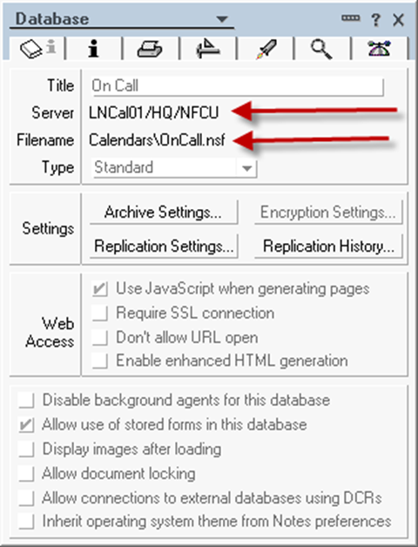
Determine the address of the Lotus Notes database.
In Notes, select the database icon and choose file, application properties.

Slide 4
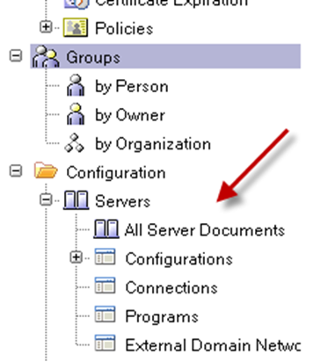
From the dialog box record the server name and file name. In this case: Server = LNCal01/HQ/NFCU (transpose to SVR-LNCAL01.nfcu.net) File Name = Calendars\OnCall.nsf Open the Lotus Notes Name and Address database. Click on Configuration, Servers, All Server Documents:

Slide 5
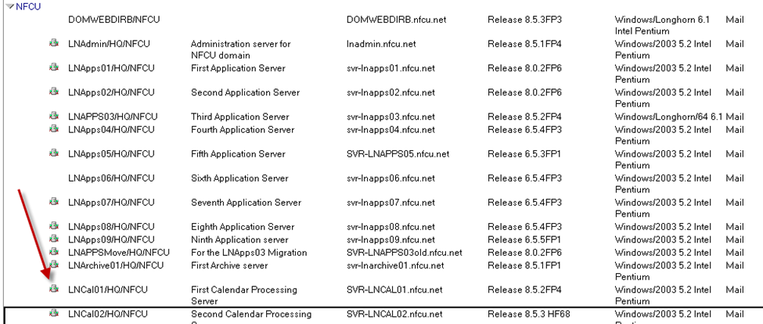
Find LNCal01 and open document:

Slide 6
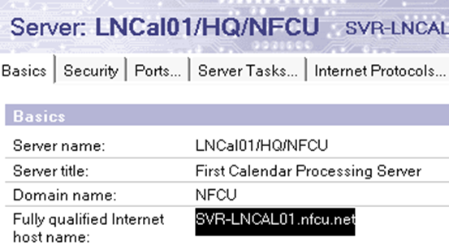
Capture the “Fully qualified Internet host name”:
The format for the link is:
Notes://ServerName/Directory/DatabaseName.nsf ?OpenDatabase
So in our case:
http://svr-lncal01.nfcu.net/calendars/oncall.nsf?OpenDatabase
Server Directory File Name

Slide 7
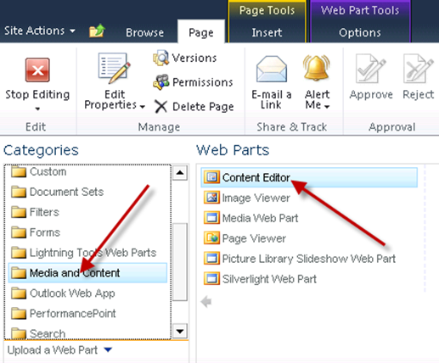
Create a new web part page.
Insert a Content Editor Web Part. (Media and Content group).

Slide 8
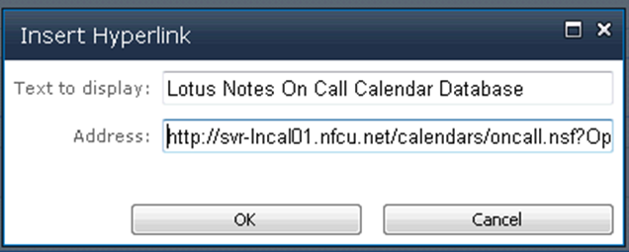
Insert a Hyperlink in the Content Editor Web Part using a place holder address:
This can be any http:// address that will be modified later.
Save the page.
This hyperlink will resolve and open the Lotus Notes database in a browser window.
To change this to open the database by launching the Notes Client:
Edit the page.
Select the web part that contains the hyperlink and place the cursor in the web part as if to add new content.
Select “HTML” from the ribbon bar and choose “Edit HTML Source”.

Slide 9
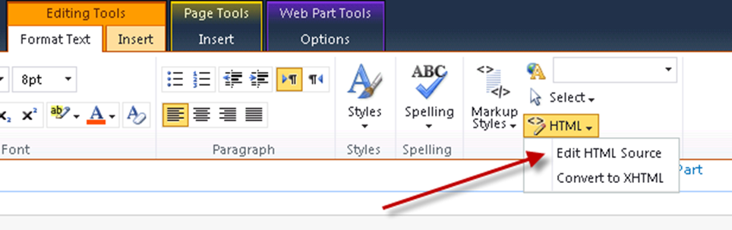
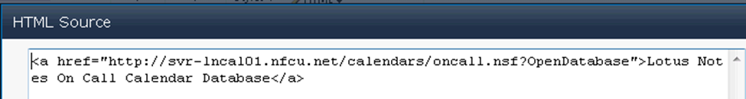
Modify the following HTML:
<a href="http://svr-lncal01.nfcu.net/calendars/oncall.nsf?OpenDatabase">Lotus Notes On Call Calendar Database</a>
To:
<a href="notes://svr-lncal01.nfcu.net/calendars/oncall.nsf?OpenDatabase">Lotus Notes On Call Calendar Database</a>
Save the page.
When clicking on the hyperlink you will be prompted to allow the browser to open the application:

Slide 10
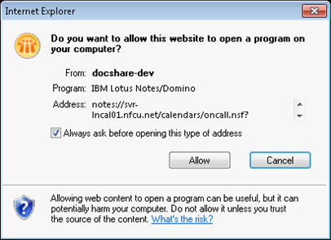
Link to a View
To link to a specific view you will need to know the name of the view. For our example the view is “By Section”. Using the format of server, folder, database, view name, we then create the following URL with the “?OpenView” postfix.
notes://svr-lncal01.nfcu.net/calendars/oncall.nsf/By Section?OpenView

Slide 11
Link to a Document
To a create a document link you will need to obtain the unique document identifier.
With the Lotus Notes open do a right mouse click and choose “Document Properties”.
With the dialog box open click on the “+” tab.
Place the cursor in the identifier field and select all the text. Please note that the text string is larger than the displayed area.
In our example the identifier looks like this:
Notes://LNCal01/85257466006BF1C8//679943F2BB8BED0B85257B01006BF4CD
The last part of the string after the two back slashes is the document ID:
679943F2BB8BED0B85257B01006BF4CD
The URL to open the document is then:
notes://svr-lncal01.nfcu.net/calendars/oncall.nsf/By Section/679943F2BB8BED0B85257B01006BF4CD?OpenDocument

Slide 12
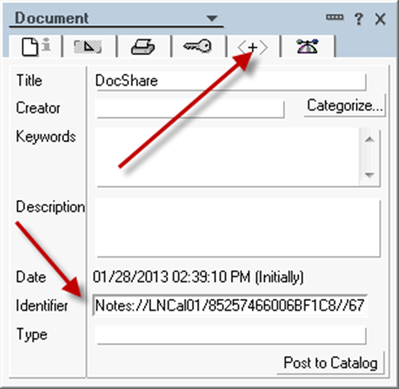

Slide 13
Resources:
Demo Page
Open a Lotus Notes database from Microsoft SharePoint 2007
Domino URL Cheat Sheet

